Slide 1
Assignment 1C Presentation EECE 443 Team 2: MCU TNC Design Kaleb Leon – C00094357 Kobe Keopraseuth – C00092349 David Cain – C00043561 March 10th, 2020

Slide 2
MCU TNC Assignment 1C
David Cain, Kobe Keopraseuth, and Kaleb Leon

Slide 3
Adjustments
References needed to be corrected to include the Direwolf project as a previous research of work done by others
Included an HDLC diagram in the research of work done by others sections
References needed to include the mentors with their credentials
Included a AFSK diagram to visualize the modulation technique
Included programming language alternatives and tradeoffs
Included basic algorithm alternatives and tradeoffs
A corrected objective tree was created to be more legible for presentations/inclusion in the paper
Grammatical Errors

Slide 4
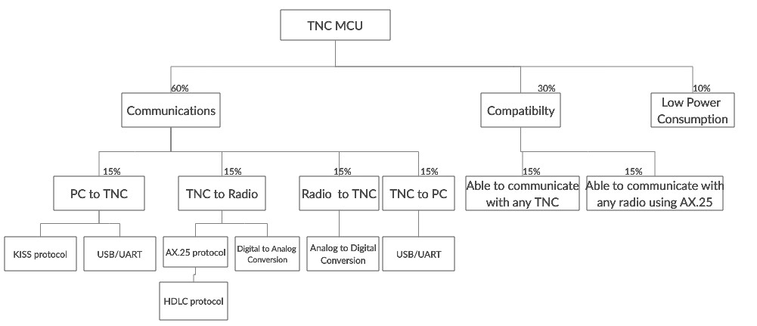
Corrected Objective Tree

